Slide 1
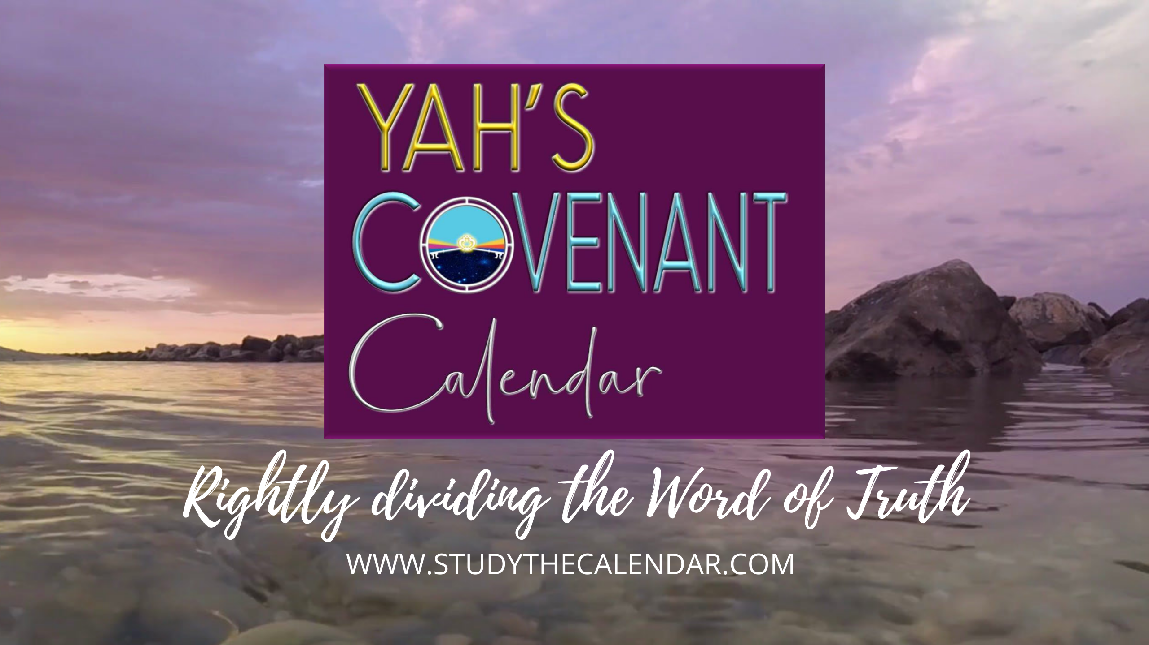
Calculating Atonement Correctly

Slide 2
Tishri 10 – The
Atonement Cycle
Yahuah’s most Solemn Mo-ed of all!
Notes:
Calculating Atonement Correctly Truly There can be only One Covenant Calendar... Jan 28th (Mario’s Version)
In this week's class Our main source text comes from Leviticus 23:27-32
Charlene wouldn't you agree that it's HIGH TIME our brothers & sisters understand the correct way to walk IN COVENANT with our Creator and observe the Festival of Atonement on Yahuah's Calendar
- the Covenant Calendar that the Hebrew nation agreed to 3 times before it was ratified in blood at Mt Sinai ?
What do you say Charlene ?
We invite you to join us on CCC for an extremely interesting and revealing investigation of the commands concerning Yahuah's Sabbath of Atonement on the 10th day in the 7th month..
Here are some questions that will be addressed...
Are we to believe that Yahuah changed His mind, somewhere between verse 27 & verse 32 ?
Why have we been taught to start the Sabbath "Day of Atonement" at the evening of the 9th ?
Did Yahuah provide us with a reason for the "instant controversial and uncharacteristic switcheroo" ?
Should the "Day" of Atonement actually be called the "Days" of Atonement ?
If Atonement day is in fact an anomaly and is totally different in its pattern from the other Mo-edim (Feast) patterns, where do we find this explanation in the Scriptures ?
If any of these questions are intriguing to you, or if you think you know the answers and are looking for biblical confirmation, be sure to show your beautiful faces at CCC study this friday February 02/19
The 18th day of the 11th month for Covenant Calendar counting (Ps 90:12).

Slide 3
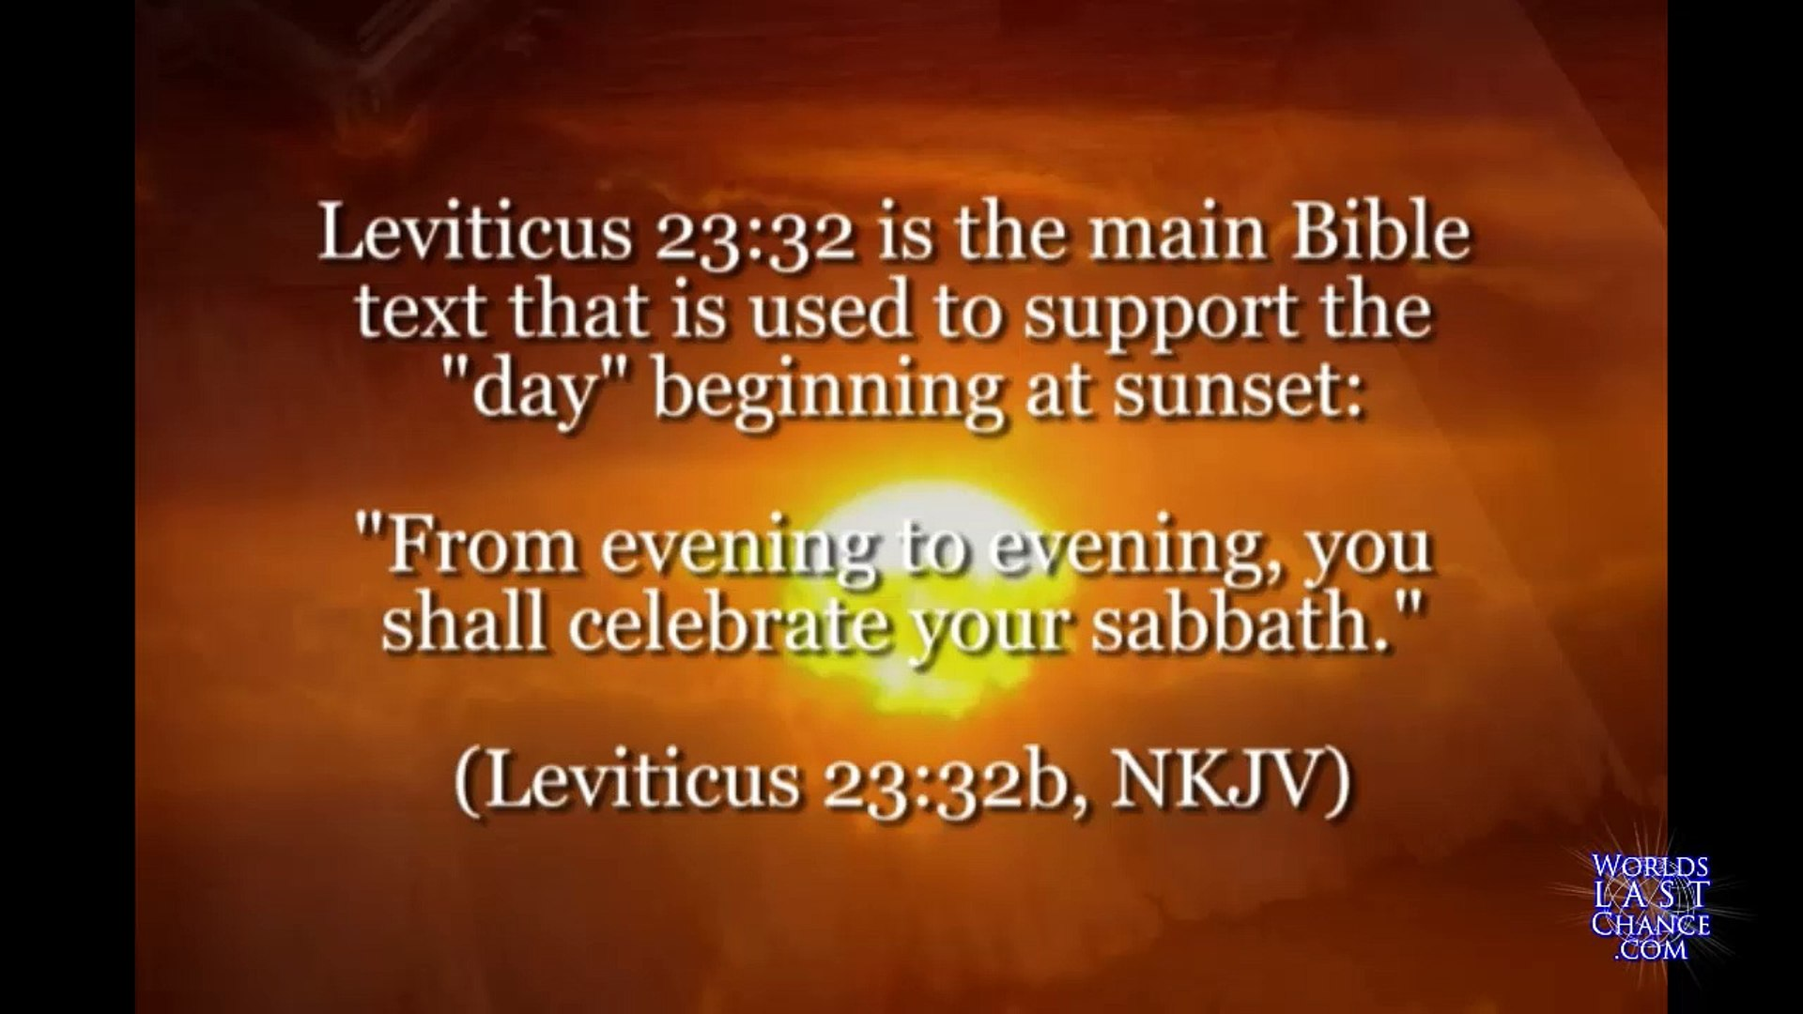



At total of only 9 words …
Remember:
Lev 23:26-32 has a total of 177 words. The last 9 words of the Atonement content are used to determine the day-start for ALL yearly Sabbaths.
That’s only 5% of the words to establish a doctrine!

Slide 4
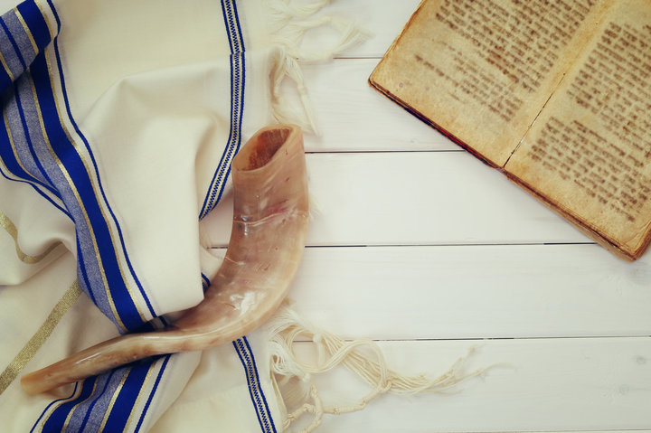
Questions for Atonement
2. What two characteristics that begin the
Atonement Sabbath
by the evening of Tishri 9 cause it to take part
on two days? Would a “false mixture” and tradition have an effect?
1. When does the actual Sabbath Day of Atonement begin and when does it end??
3. What are we commanded to begin on the evening of Tishri 9?

Slide 5
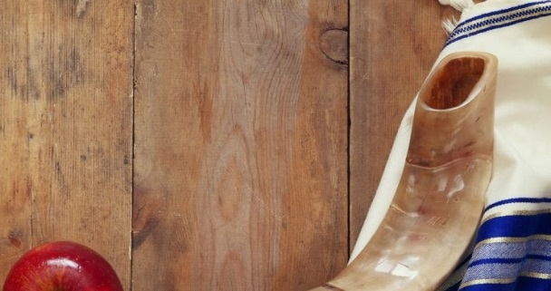
Malachi 3:6 declares Yahuah does not change.
Creation week declares all days begin at Dawn.
Many feast calendars, AND FEAST KEEPERS declare Day of Atonement Sabbath begins at the dusk of sunset on the 9th day.
Another Question
Where is Yahuah’s Scriptural exemption to commence His
Day of Atonement at “another time” other than what He has declared?

Slide 6

Final Questions
Is it possible that you have heard it said that the weekly Sabbath begins at sunset and then Lev 23:32 is referenced for support?
Have you ever questioned why Yahuah never informed us why
He waited from creation until Mosheh received the instructions from the top of Mt Sinai (approx. 2500 years later) to explain the perimeters of the 7th Day Sabbath?
Have you ever seen a text where Yahuah stated one fact,
then changed His mind and delivered an opposing command –
both within one text?
These are some questions that we will be looking at very closely.

Slide 7
Leviticus 23:27-32 delivers to us: #1 – A Premier Statement of timing –
The 10th day of the 7th month.
Lev 23:27(a) “On the TENTH DAY of this seventh month is
The Day of Atonement.
There can be no mistake that Yahuah wants us to understand that
the 10th of Tishri is the APPOINTED TIME.
Then we see 6 additional reference points indicating that Tishri’s 10th cycle of the 7th month, is the one and only cycle of the year determined by Yahuah to be
THE DAY for Atonement.
Ultimately, Who gave this definitive statement of timing for the Day of Atonement?
Lev 23:26 And יהוה [Yahuah] spoke to Mosheh, saying,

Slide 8
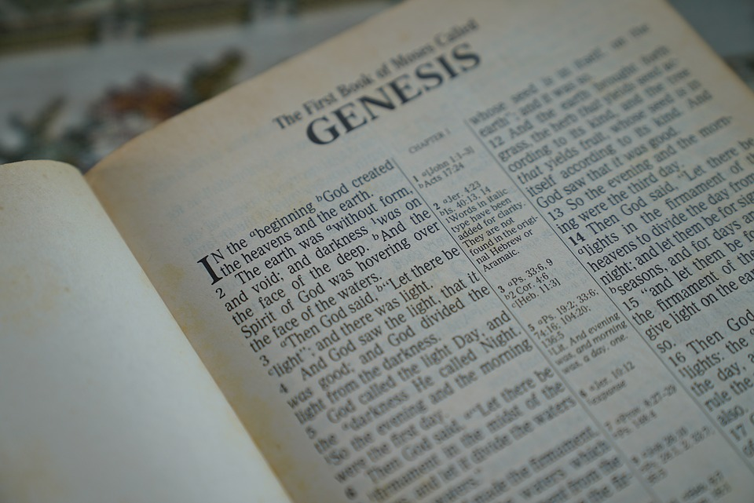
The commencement and termination
of this solemn festival is
FIRMLY ANCHORED
in the Creation account.

Slide 9

.
What qualifies the CALIBER of this cycle?
Lev 23:27 “On the TENTH DAY of this seventh month is
The Day of Atonement.
Can we safely assume from this text, that the 9th of Tishri is ALSO a
set apart convocation?
Where in the Scriptures do we find a similar or otherwise statement declaring the 9th of Tishri as a Qodesh Convocation?
WHERE????????????
It shall be a SET-APART GATHERING for you.

Slide 10

.
The Premier Point of Assertion:
Lev 23:27(a) “On the TENTH DAY of this seventh month is The Day of Atonement.
Let’s look at the 6 reference points pointing to the 10th cycle of Tishri.
Please note very carefully the SINGULAR form of text used to describe – The Day of Atonement as opposed to a plural effect – The Day(S)
{of Atonement}. This makes it very difficult to rationalize the Day of Atonement starting on the 9th cycle of the month and ending on the 10th cycle of the month. That would involve TWO cycles of the month!

Slide 11

.
Again - The Premier Statement – Lev 23:27 (b)
Lev 23:27 “On the TENTH DAY of this seventh month is
The Day of Atonement.
shall be a SET-APART GATHERING for you.
#1!
IT

Slide 12
.
Reference #2 – Lev 23:28 (a)
And you do no work on THAT SAME DAY,
Lev 23:27 “On the TENTH DAY of this seventh month…
Reference #3 – Lev 23:28 (b) for IT is the Day of Atonement,
to make atonement for you before יהוה your Elohim.
9th ?

Slide 13
.
Reference #4 – Lev 23:29
“For any being who is not afflicted on THAT SAME DAY, he shall be cut off from his people.
Reference #5 – Lev 23:30
“And any being who does any work on THAT SAME DAY, that being I shall destroy from the midst of his people.
Lev 23:27 “On the TENTH DAY…

Slide 14
.
Reference Point #6 – Lev 23:32 (a)
“IT is a Sabbath of rest to you, and you shall afflict your beings.”
Yes, this “it” word is once again referencing the 10th cycle of Tishri.
A Summary
Thus far Yahuah has declared by a Premier Statement (Lev 23:27a)
and then referenced directly to the same - 6 additional times - that
the SINGLE cycle of Atonement is on Tishri 10.
There has been zero mention of Tishri 9 up to this point.

Slide 15
.
We now come to what has been a very controversial part of the text –
Lev 23:32 (Part b).
We have already been THOROUGLY informed of the “what” - {Tishri 10!}.
Now we are about to learn of the “how” and most interestingly –
the “WHEN” – of the “how”!
Lev 23:32 (a) “It is a Sabbath of rest to you, and you shall afflict your beings.
(b) On the ninth day of the month at evening …”

Slide 16
.
The – “How” –
Lev 23:32 (a) “It {Tishri 10} is a Sabbath of rest to you,
and you shall afflict your beings.
What we are “to DO” is to afflict our souls!
This study has no intention of delving into the meaning of the word “afflict,” in this session.
Our focus for this study is about – the timing of the affliction.
The pertinent question then is –
What time of the cycle and date of the month should this AFFLICTION COMMENCE?

Slide 17
.
Question: When Yahuah indicates the 9th cycle of the month –
“at evening,” exactly what part of the 24 hour cycle is this?
Before we can determine what the celebration theme for the Festival of Atonement is, we need to establish exactly when this “evening” time is.
The Hebrew word for evening is <ereb> - ע ר ב ..
Let’s look at some definitions for this word.
A Hebrew English Lexicon by John Parkhurst (1762)
Evening - ע ר ב
“The evening air from the western or darkened part of the heavens
begins to mix with the day, which mixture continues till night, when the
day is overpowered the darkness prevails and the mixture of daylight ceases.
Gen i.5, xxiv.11.”

Slide 18
.
A Hebrew Lexicon by W. H. Barker (1776) (page 148)
Evening - ע ר ב
to mix, mingle: the evening, when darkness mixes with the light, to be darkened, obscured, the woof: to be intermixed with the warp, a mixed multitude, swarm, the willow - it being of a mixed colour, pale on one side and green on the other, the weft, evening.
Etymological Dictionary of the Hebrew Language: <`ereb> - ע רב,
(some definitions apply to Light), to set (said especially of the sun), to enter, to go in, to go down, it became evening, it grew dark, sunset, evening, mixed, to mix, was mixed, was mingled, mixture, woof.
Question: What is “woof”? Let’s check the Webster’s Dictionary first and then the Strong’s Concordance.
Answer: Woof = to weave, the threads that cross the warp, the weft.

Slide 19
.
Strong’s OT:6154 – Woof, Mixed multitude, Mingled people - ע רב: <`ereb>; or
`ereb; (ay'-reb); (1 Kings 10:15), from OT:6148; the web (or transverse threads of cloth); also a mixture, (or mongrel race): KJV - Arabia, mingled people, mixed (multitude), woof.
OT:6148 `arab; (aw-rab'); a primitive root; to braid, i.e. intermix; technically, to traffic (as if by barter); also or give to be security (as a kind of exchange): KJV - engage, (inter-) meddle (with), mingle …
Note: The variety of meanings for OT:6154 strongly suggests …
“a mixing/mingling.” That’s because, in Hebrew, OT:6154 is a family word
with OT:6153 [even/evening] - meaning there will be strong similarities.

Slide 20
.
What two specific time frames are identified when this verb with a mixing effect is applied to a 24 hour cycle? The two twilights?
When does the light and darkness form a mixing action?
Is it somewhere after the direct sunlight has been removed after the heat
of the Light Season?
Note: the qualifier for pointing to the pre-sunrise mixture of light and darkness is not seen in these verses of Leviticus 23:27-32!
Therefore we will not be looking to Dawn!
The - ע ר ב : <ereb> (evening MIXTURE) is after the sunset has occurred,
thus allowing the mixing of soft sunlight with the ensuing darkness.
The absence of direct sunlight allows the MIXTURE effect needed to
fulfill the Hebrew definitions.

Slide 21
.
Here is our pertinent text again to refresh our memories.
Lev 23:32 (a) “It is a Sabbath of rest to you, and you shall afflict your beings.
(b) On the ninth day of the month at evening...”
We will now look to charts for the light mixing with darkness part of
the 24 hour cycle.
The full purpose of this chart is to expose the exact location of the mixing of light with darkness (evening) factor for the 9th cycle of the month.
The erroneous Sunset Theory teaching that Atonement Sabbath starts
directly before (or after) the sunset will be exposed soon.
Does the Sabbath of Atonement begin on the 9th EVENING of the month, or can it possibly be something else that starts there? Let’s look at it, shall we?

Slide 22

On the next slide is a statement showing the results of starting the Atonement Sabbath at sunset of Tishri 9.
It exposes the situation which occurs when starting the Atonement Sabbath on the evening of the ninth of Tishri.
We will then examine why this unique situation would, (or would not) exist and see if there is Scriptural support for either scenario.
Note where the green oval sits.
This is where a HUGE problem area exists!

Slide 23
Summary of Atonement Days according to Sunset Theory.
Question: How can Tishri 9 be a Preparation Day for the Sabbath of Atonement
on Tishri 10, and a Sabbath day as well??
Atonement Day(s) of Sunset Theory?
Sunset
Tishri 9 - “Even” mixture of light & darkness
“Even” of Tishri 10 - Atonement Day
Sunset
Sunset
24 HRS of affliction
2nd 24 HRS of affliction
24 HRS of Sabbath
2nd 24 HRS of Sabbath
8 |  | Tishri 9 Preparation/Sabbath (???) | Tishri 9 Preparation/Sabbath (???) |  | Tishri 10 Atonement Sabbath | Tishri 10 Atonement Sabbath
Atonement Day(s) (?) – 48 hours – Tishri 9 & 10 – Scriptures? Atonement Affliction – 48 hours – Scriptures?

Slide 24
.
Sunset Theory!
Please note the location of the 9th cycle evening (after sunset - coloured purple
for identification purposes) on the left side of the chart.
The sunset of the 8th day occurs and then the mixture of light and darkness commences, initiating the evening mixture of the 9th of Tishri
– all 24 hours of the 9th begin here!
Sunset changes the “day” here! (???)
Sunset
Sunset
8th
9th of Tishri
9th of Tishri
There can be only be ONE evening mixture per 24 hour period.
It is at this point that some declare the start of Atonement Sabbath Day! (???????)

Slide 25
.
Sunset Theory!
Reminder: 9th cycle evening.
Again: The Sunset, preceding the 9th of Tishri evening, is declared by many as being
the start of the Atonement Sabbath!
That means the first 24 hour period of Atonement Sabbath would begin here – BEFORE THE 10TH OF TISHRI HAS HAD A CHANCE TO BEGIN!
Sunset changes the “day” here! (???)
Sunset
Sunset
8th
9th of Tishri
9th of Tishri
Tishri 9th - 24 hours of Atonement SHABBATH!??
That is 24 hours of Atonement - BEFORE - Tishri 10 even begins!
This would be the FIRST OF TWO DAYS for Atonement celebration!

Slide 26
Tishri 9th - 24 hours of Atonement SHABBATH?
That is 24 hours of Atonement - BEFORE - Tishri 10 even begins!
This would be the FIRST OF TWO DAYS for Atonement celebration!
Where was it that the Word of Yahuah
was disregarded and
SET ASIDE - as if just more “RUBBLE”???

Slide 27
.
Sunset Theory! Tishri 10th!
Please note the location of the 9th cycle SUNSET.
Sunset changes the “day” here! (???)
The sunset of the 9th day occurs and then the mixture of light and darkness commences, initiating the evening mixture of the 10th of Tishri
– all 24 hours of it!
Sunset
Sunset
9th
10th of Tishri
10th of Tishri
The sunset has triggered the start of the 10th of Tishri.
At this point, there has ALREADY BEEN 24 hours of Atonement day –
IF -
THE EVENING OF THE 9TH STARTS ATONEMENT DAY!
Does Yahuah require 2 week days/ 48 hours of Atonement affliction?

Slide 28
.
The Common Mistake
In Sunset Theory it is common to reckon the evening twilight BEFORE the sunset, allowing the usage of Tishri 9 for the start of the Day of Atonement.
One Sunset Theory cycle
Sunset Dawn Sunset Dawn
DIRECT SUNLIGHT PREVENTS A LIGHT/DARKNESS MIXTURE HERE! The Hebrew definitions cannot be fulfilled here! Declaring an evening here, VOIDS YAHUAH’S WORD! The ereb (evening twilight MIXTURE) - NORMALY - cannot occur before the sunset!
HOWEVER … - Yahuah’s Twilight Mixing of Light/Darkness is here!
Tishri 9
Tishri 9
Tishri 10

Slide 29
.
Does Tishri 9 exclusively have TWO EVENINGS?
One Sunset Theory cycle
Sunset Dawn Sunset Dawn
But man, in order to prevent a 48 hour Atonement Sabbath, defies the Hebrew definitions of the word – EREB – (A MIXING EFFECT.) Man desires to place the 2ND ereb (mixture) of Tishri 9, PRIOR TO SUNSET
WHERE THE DIRECT RAYS OF SUNLIGHT PREVENT ANY DARKNESS
FROM MIXING WITH THE LIGHT OF DAY!
Yahuah’s Tishri 9th Twilight Mixing of Light/Darkness is here after a sunset!
Look at this carefully! Is it correct to apply TWO EVENING MIXTURES in ONE 24 hour period?
Tishri 9
Tishri 9
Tishri 10

Slide 30
When man defies the Hebrew word definitions, is man at the same time DEFYING YAHUAH’S COVENANT OF THE DAY AND THE COVENANT OF THE NIGHT?
Jer 33:20
When man declares darkness occurs before sunset,
is this a confusion of Yahuah’s Covenant of the day?

Slide 31

A Complicated Problem Needing a Solution!
If sunset theory wants to have Tishri 10 as the Day of Atonement then
“this theory” has no choice but to claim that Tishri 9 has two evenings like this:
An “evening” after the sunset of Tishri 8 that BEGINS the 9th day …
and an “evening mixture of light and darkness” PRIOR TO AND DURING
the sunset on Tishri 9 to END the 9th day.
Sunset Theory would then be demanding TWO EVENINGS, BACK TO BACK
split by a sunset!
Who ever heard of
any day having
2 evenings?
Notes:
Kelowna Jan 20/19 … Okanagan Lake by Catherine Hutchins

Slide 32
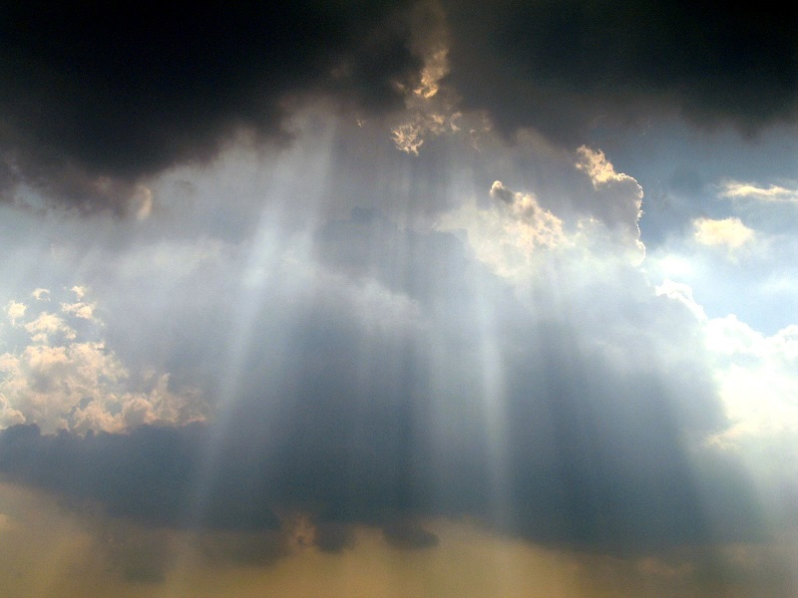


A Solution to the Problem!
Yahuah’s Covenant Calendar requires Tishri 9 to need only
1 evening (not 2) to honor the celebration guidelines
for Tishri 10!
Next, we will be examining every segment of verse 32 for
a complete understanding of the true context of this verse.

Slide 33

There are 2 times when, by Divine intervention, it became dark during the time when the sun was high in the sky!
The 3rd event is under question.
When the plague of darkness blackened Egypt and Pharaoh’s heart!
When at Golgotha with Yahusha hanging on the cross, it became dark from the 6th hour from Dawn, until the 9th hour from Dawn.
The dark day of May 19, 1780 in New England & Canada. This event is definitely questionable and up for deep discussion.
How often have you seen darkness
take over the sky when the sun is still directly shining on the land?

Slide 34
It makes no sense whatsoever to have the Day of Atonement
start at sunset. By default of sunset theory characteristics,
total misalignment with Genesis 1 and Yahuah’s Statutes becomes inevitable.
The questions then are –
A) When does Tishri 10 begin?
B) What commences in the evening of Tishri 9?
We are told to come to Yahusha as little children
(ready to learn from an uncluttered platform).
Matt 18:3 And said, Verily I say unto you, Except ye be converted, and become as little children, ye shall not enter into the kingdom of heaven.

Slide 35

Let’s put on our “little children hats” ☺ and look at what
the Scriptures declare for
the start of Tishri 10 –
The Day of Atonement!

Slide 36
.
Covenant Calendar – Tishri 9!
Please note the 9th of Tishri morning ereb (twilight mixture) before the sunrise!
The sunset of the 9th of Tishri occurs and the ereb (evening twilight mixture period) ushers in the Night Season.
WHAT ELSE does this ereb initiate???
Tishri 9 starts at Dawn as per Gen 1 - Creation.
Dawn
Sunrise
Sunset
8th
9th of Tishri
9th of Tishri
There is an extremely important aspect that is very
specifically actuated by the evening mixture
of Tishri 9. However, we will continue by looking at the
timing of Tishri 10 according to Yahuah’s Covenant Calendar!

Slide 37
.
Covenant Calendar – Tishri 10!
Note: the 10th of Tishri morning ereb (twilight mixture) BEFORE the sunrise!
Tishri 10 starts at Dawn as per Gen 1 - Creation.
Atonement Shabbath begins at the first light of Dawn and lasts until the following Dawn!
24 hours ONLY of Tishri 10 Shabbath!
Dawn
Sunrise
Sunset
9th
Tishri 10th - Atonement
10th of Tishri

Slide 38
.
Covenant Calendar – Tishri 10!
Note: the 10th of Tishri morning ereb (twilight mixture) BEFORE the sunrise!
Tishri 10 starts at Dawn as per Gen 1 - Creation.
Atonement Shabbath begins at the first light of Dawn and lasts until the following Dawn!
24 hours ONLY of Tishri 10 Shabbath!
Dawn
Sunrise
Sunset
9th
Tishri 10th - Atonement
10th of Tishri
The actual physical Shabbath of Atonement day begins exactly as every other day since creation with the eyelashes of Dawn! Job 3:9!

Slide 39
.
When does the Sabbath of Tishri 10 - END?
Lev 23:27 – On the tenth day of this seventh month is Yom Ha’ Kippurim [Day of Atonement]. It shall be a qodesh gathering for you. …
Tishri 10 starts at Dawn as per Gen 1 - Creation.
Day, “Yowm” not only means the Light Season but it defines a 24 hour period also. ***
When Yahuah desires to be PRECISE about
INDIVIDUAL time related identities, HE INFORMS US!
Thus saith [Yahuah]; If ye can break MY COVENANT of the day,
and MY COVENANT of the night, and that there should not be
day and night in their season … Jer 33:20.

Slide 40
.
Why then do we NOT see -
On the TENTH LIGHT SEASON {PRECISION and ACCURACY} of this seventh month as Yom Ha’Kippurim (Day of Atonement).
It
shall be a QODESH GATHERING to you.
Dawn
Sunrise
Sunset
Why did Yahuah NOT GRASP this GOLDEN OPPORTUNITY to define with absolute precise accuracy, LIGHT SEASON ONLY perimeters of Atonement Shabbath? (As well as the other Shabbaths?) Why did Yahuah not define with blinding accuracy that Atonement Shabbath ended with the LIGHT SEASON?
9th
Tishri 10th - Atonement

Slide 41

.
Why is it that in Genesis 1,
“Day One” ended at Dawn,
“Day Two” ended at Dawn,
“Day Three” ended at Dawn,
“Day Four” ended at Dawn,
“Day Five” ended at Dawn,
“Day Six” ended at Dawn,
“Day SEVEN” ended at Dawn,
Matt 28:1 – the Shabbath ended at Dawn,
Exo 12:10,11/ Luke 23 – The “Preparation Day” ended at Dawn;
And - there is no Hebrew word that defines a Shabbath that does
NOT require a “REST PERIOD” FROM THIS WORLD’S ACTIVITIES!
Why do we NOT find Yahuah’s instruction to end the Shabbath at the end of the twilight? Why do we not find this specific pattern anywhere in the Scriptures?
What gives us the right to claim the A/S ends at twilight just because the Atonement observation theme does?
OK! Let’s move onto a very interesting section of Lev 23:32!

Slide 42
Lev 23:32 (b)
On the NINTH day of the month AT EVENING… (<ereb>)
Yahuah commands SOMETHING to happen!
What is it?

Slide 43
We have observed Sunset’s Theory claim for Atonement day to begin at sunset on the 9th of Tishri being laid out clearly onto charts.
We have seen … by default the Atonement day will stretch
over a period of 48 hours!
Is it becoming quite clear that many have not understood
the Scriptures correctly?
What other meaning could there possibly be that will find alignment with the Scriptures beginning in the evening prior to
the start of Tishri 10?
Let’s look at the Scriptures once again -
It must be something that is integrally connected with Atonement day!

Slide 44
Lev 23:32 (a) It is a Shabbath of rest to you, and you shall afflict your beings.
The Shabbath of the 10th day of Tishri (Lev 23:27) has for the 6th time, once again, been referenced. We are then told of the type of theme – affliction - by which we are to conduct ourselves within this ultimately important cycle. Then comes the second part of the verse –
Lev 23:32 (b) On the NINTH DAY OF THE MONTH AT EVENING [EREB]…
We have just been informed of the starting point of
the AFFLICTION!

Slide 45
The time to begin our personal “affliction” is at the – ereb –
{the evening twilight — the light and darkness mixture by definition}.
In terms of timing - there is no place existing, neither in this very verse nor elsewhere in the Scriptures, that would indicate in any way that this Feast of Atonement is an anomaly.
The Shabbath for the Feast of Atonement always begins exactly the same as every other cycle — at
DAWN!

Slide 46
After the sun has set on the 9th cycle of Tishri — the 7th month,
the evening timing, (which is the proper beginning of the
OBSERVATION THEME), ushers in and signals forward to the
Sabbath of Atonement which begins at the inception of the
BOQER TWILIGHT.
Consider very carefully the Words as
they are preserved by Yahuah.
The Hebrew words within verse 32 (or any other verse) never
indicate the Shabbath of Atonement begins at sunset.
To claim otherwise is a full misconstruing of the Words of Yahuah!
But there is more!

Slide 47
Lev 23:32 (c) … from [ereb] evening to [ereb] evening …
That is by Hebrew definition –
From the MIXING of light and darkness, after the sun has set, until 24 hours later when, once again, the sun has been removed from our sight and the light and darkness MIXTURE commences.
In other words – Yahuah’s APPLIED CELEBRATION THEME for the Set-Apart Feast of Atonement begins with an evening MIXTURE and ends at the next evening MIXTURE. These are the time parameters for the observation theme only – nothing added and nothing taken away.
Let the HEBREW WORDS THAT ARE WRITTEN PREVAIL.

Slide 48
Lev 23:32
(d)
… you OBSERVE YOUR SHABBATH.
The KJV uses – celebrate – here. There is no way this phrase can be construed to say – your Sabbath of Atonement starts here, not according to the written words. When the Premier Statement with the 6 additional references to the 10th of Tishri for the Atonement Shabbath are considered, it becomes clear that this phrase points to the theme implied by which to regard the Atonement Shabbath.
This 12 hours (approx.), from Evening until Dawn, is a mindset preparatory period for the Actual Atonement Shabbath.
To/and for - Yahuah … that is a “celebration”!
Let’s look at this concept in a chart format and see if it upholds the statutes.

Slide 49
.
Covenant Calendar – Tishri 9!
Note the 9th of Tishri morning ereb (twilight mixture) before the sunrise!
Tishri 9 has a normal Preparation Light Season. We are to perform normal
life’s duties providing it does not fall
on a 7th day Sabbath.
Tishri 9 starts at Dawn as per Gen 1 - Creation.
Dawn
Sunrise
Sunset
8th
Tishri 9 Light Season
Tishri 9 Night Season
Tishri 9 starts at Dawn and ends at Dawn. It always contains two twilight mixtures … one before Sunrise and one after the Sunset.
Dawn to Dawn – 24 hours! ☺
We will be returning to this particular sunset in a couple of slides!

Slide 50
.
Covenant Calendar – Tishri 10!
Note the 10th of Tishri morning ereb (twilight mixture) Light before the sunrise!
Tishri 10 starts at Dawn as per Gen 1 - Creation.
Atonement Shabbath begins at the first light of Dawn and lasts until the following Dawn!
24 hours ONLY of Tishri 10 Shabbath!
Dawn
Sunrise
Sunset
9th
Tishri 10th - Atonement
10th of Tishri
The simplicity created by Yahuah is awesome!
But what about the “EVEN TO EVEN” starting on the 9th of Tishri???

Slide 51
.
Covenant Calendar – Tishri 9!
From Even to …
Tishri 9 starts at Dawn as per
Gen 1 - Creation.
Preparation day – Tishri 9. We have been given a very special command for the precise time when the moment the sun has removed itself.
Dawn
Sunrise
Sunset
8th
Tishri 9 Preparation
Tishri 9 - Night Season
Lev 23:32 – On the ninth day of the month at evening, from
EVENING TO EVENING,
you OBSERVE your Shabbath.
The timing for this command
is AFTER THE SUNSET,
not before
as rabbinical desires at times demand us to believe.

Slide 52

.
Covenant Calendar Tishri 9 – Preparing for Atonement Sabbath!
From Even (Ereb 9th) to Even (Ereb 10th)
Dawn
Dawn
Sunrise
Sunset
Sunrise
Sunset
8th
Tishri 9
Tishri 9
Tishri 10 A/S
Tishri 10 A/S
Atonement Sabbath begins at Dawn!
Lev 23:32 – On the ninth day of the month at evening,
from EVENING TO EVENING,
you your Shabbath.
[RESPECT]

Slide 53
.
From Even (Ereb 9th) to Even (Ereb 10th)
Tishri 9 – Prepare for Atonement Sabbath!
Sunset
Sunset
Dawn
Dawn
Sunrise
Sunrise
8th
Tishri 9
Tishri 9
Tishri 10 A/S
Tishri 10 A/S
Covenant Calendar
Lev 23:32 – EVENING TO EVENING,
24 hours (ONLY) of Thematic Observation!

Slide 54
.
From Dawn (Ereb 10th) to Dawn (Ereb 11th)
Atonement Sabbath!
Dawn
Dawn
24 hours for Tishri 9
from Dawn to Dawn.
Dawn
Sunrise
Sunset
Sunrise
Sunset
8th
Tishri 9
Tishri 9
Tishri 10 A/S
Tishri 10 A/S
24 hours ONLY
of Atonement
Shabbath!
Lev 23:27 – On the TENTH day of the month is Yom ha’Kippurim [Day of Atonement].
It shall be a QODESH gathering for you.

Slide 55
.
The Observation
& The Shabbath!
Torah –
Theme Observation – Evening to Evening
Atonement Shabbath – Dawn to Dawn
24 hours ONLY of Atonement Shabbath!
Dawn
Dawn
Dawn
Sunrise
Sunset
Sunrise
Sunset
8th
Tishri 9
Tishri 9
Tishri 10 A/S
Tishri 10 A/S
24 hours of Atonement Thematic Observation.
Reminder: This study is NOT about HOW to observe the Atonement celebration, but focuses specifically on TIMING! ☺

Slide 56







Have you noticed there are 2 things to understand about this Day of Atonement Study?
Have you
noticed …
The 24 hour
(affliction) “celebration” is
from the even of Tishri 9 to even
of Tishri 10.
The 24 hour solemn “observation” is from
the dawn of Tishri 10
to dawn of Tishri 11.
… there are 2 things
to understand about
this Day of Atonement Study?
Next, we will be examining every segment of verse 32 for a complete understanding of the true context of this verse.

Slide 57
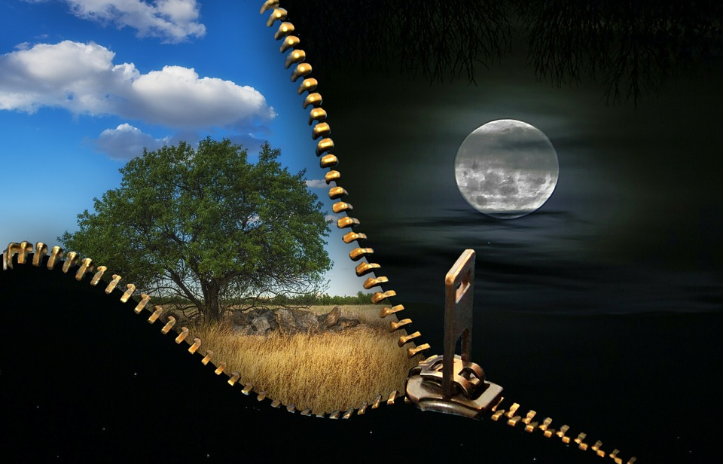
Day, “Yowm” not only means the Light Season but it defines a 24 hour period also. ***
Gen 3:14, 17; 4:3; 7:4;/ 15:18; 26:8; 29:14;
37:34; 40:4; 42:17;
Exo 12:18, 19; 14:30
Lev 13:50
Let us not forget Gen 1 at Creation – Day, 1, 2, 3, etc.
These are some verses to consider when thinking about the 24 hour period identified by – yowm.
Some are arguable, some are not. There are many more!
Notes:
Gen 3:13 – Course of time – the word Yowm is used here. These days of Cains life included the night season – 24 hours.

Slide 58

A Word from Yahuah
OT:8085 shama` (shaw-mah'); a primitive root; to hear intelligently (often with implication of attention, obedience, etc.; causatively, to tell, etc.).
Proverbs 28:9 He that turneth away his ear from hearing the law, even his prayer shall be abomination.

Slide 59


.
We have just seen the Word according to the original writings of the Hebrew language.
What you do with this information is in your hands.
The Hebrew word – ע.מ.ש. – shama – means to hear intelligently. But that is not all!
The full meaning is to HEAR with the intention to OBEY AND ACT ACCORDINGLY.
We can listen all we want but unless we are willing to take action in our lives, we are as a stone stuck in the mud.
I pray everyone, viewing the Dawn start to Yahuah’s days, will take this information to heart and act according to the Scriptures as they were written.
May Yahuah bless and guide you always.
The End
59
Dec 1 / 18

Slide 60

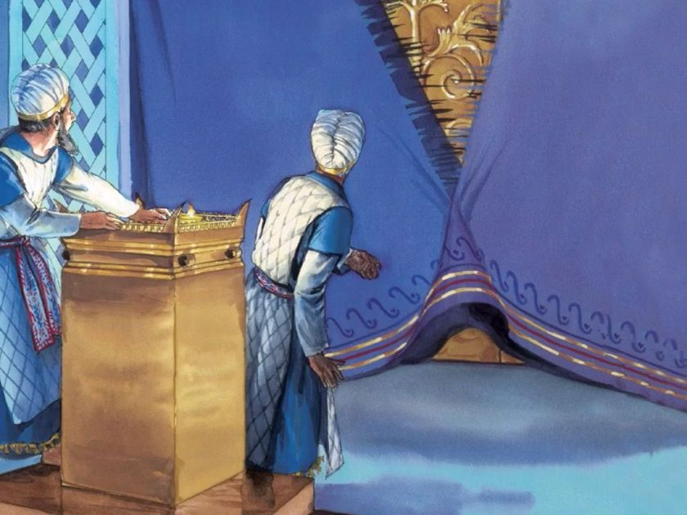
Next Presentation: Feb 15/19
When was the Veil rent in twain?
A 6th Cycle
Cruci fiction
?

Slide 61


If you need assistance with this information, please send your questions to
Timothy Astleford:
tim@studythecalendar.com
www.studythecalendar.com

